Slide 1



CREWES Data Science
Lecture 8: Regression 1
Marcelo Guarido
www.crewes.org

Slide 2

Today's Agenda
Part 1:
Machine Learning
Part 2:
Linear Regression
Part 3:
SV Regressor
Part 4:
Neural Networks
Part 5:
Live Coding

Slide 3


Part 1:
MACHINE LEARNING

Slide 4

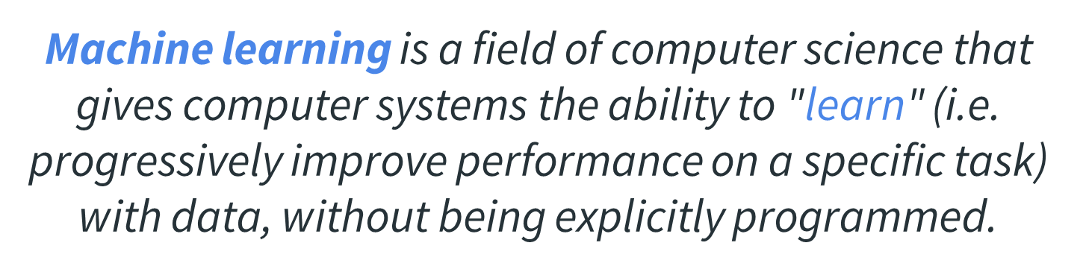

Machine Learning

Slide 5
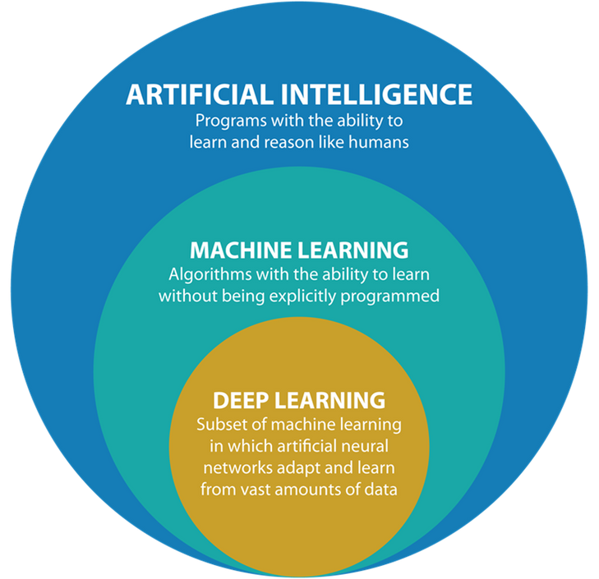

Machine Learning
Figures from Argility

Slide 6
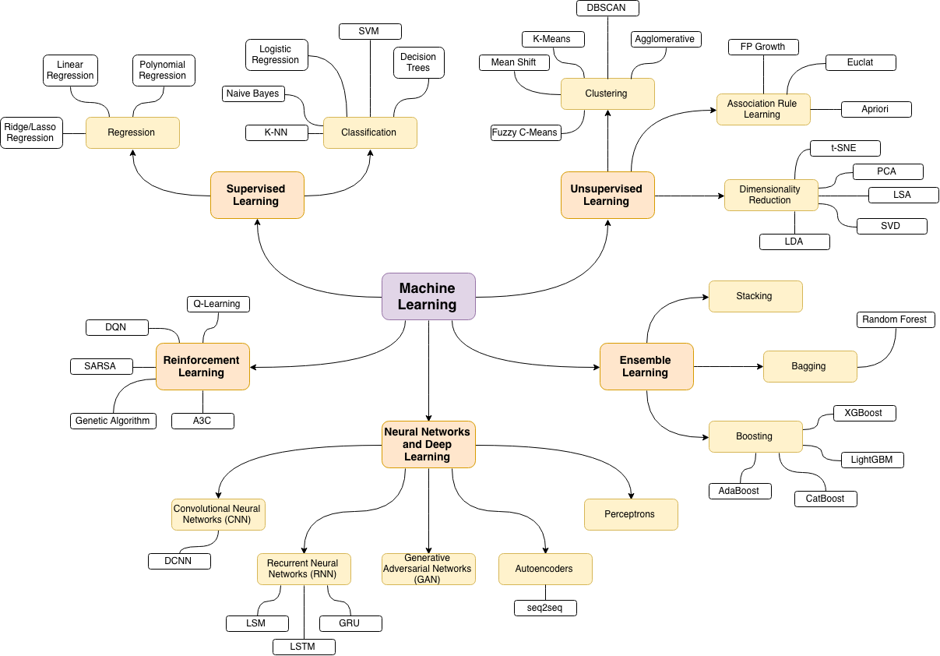

Slide 7
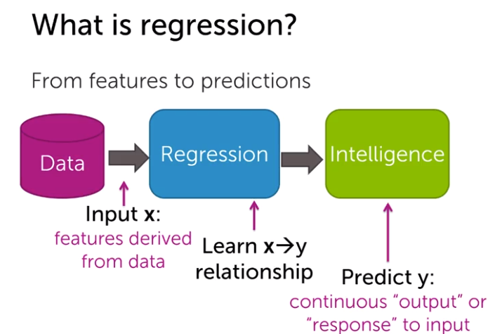
Regression
Source

Slide 8
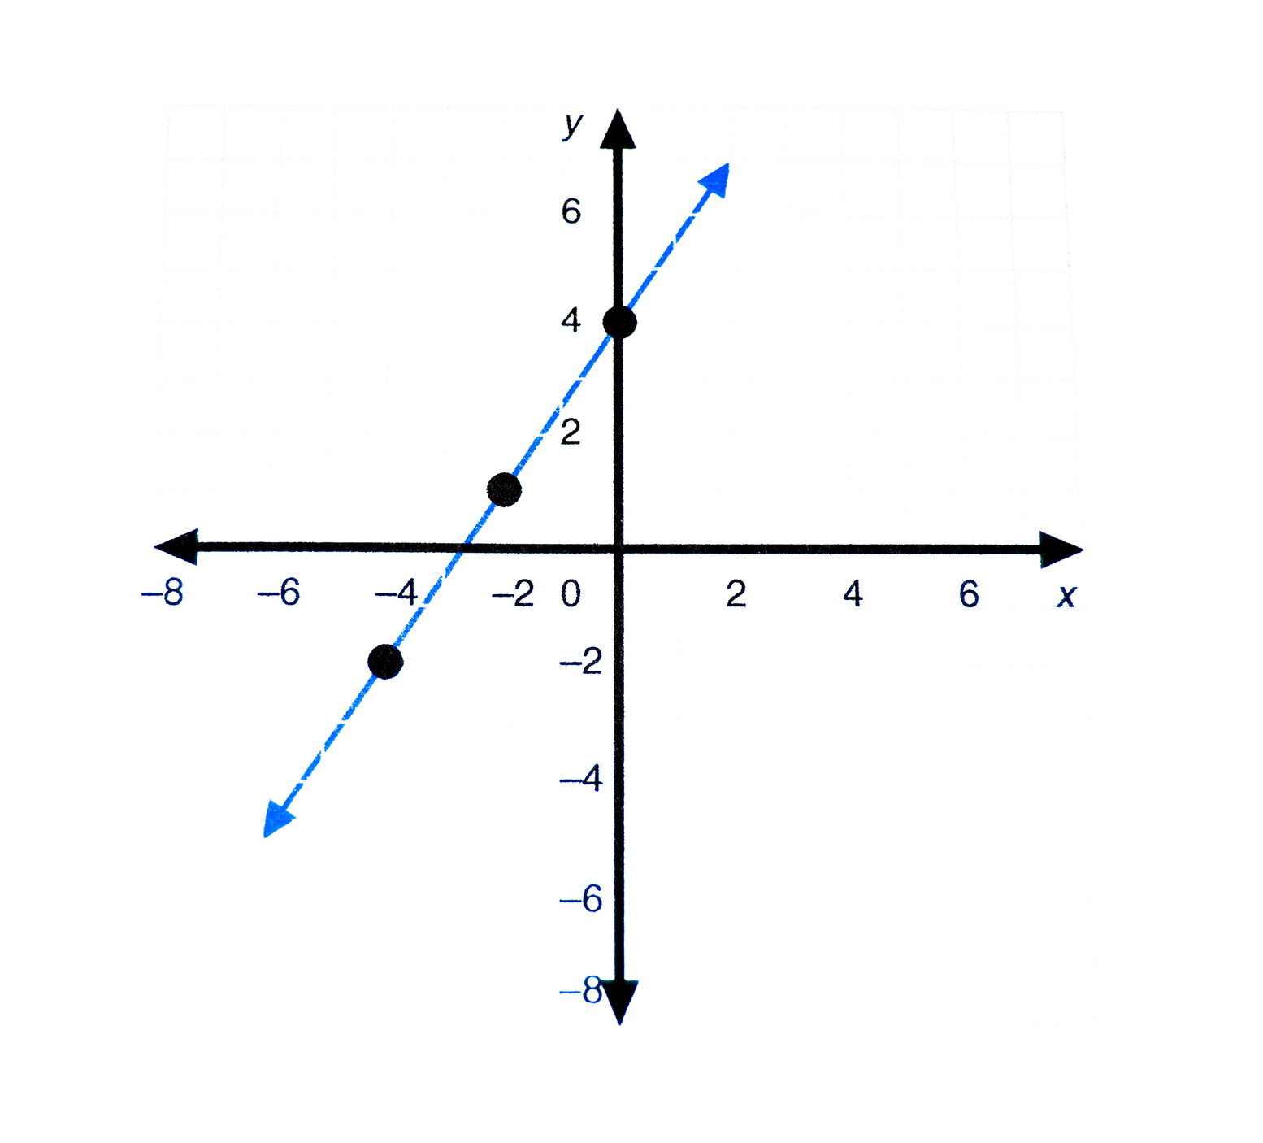
Part 2:
LINEAR REGRESSION

Slide 9
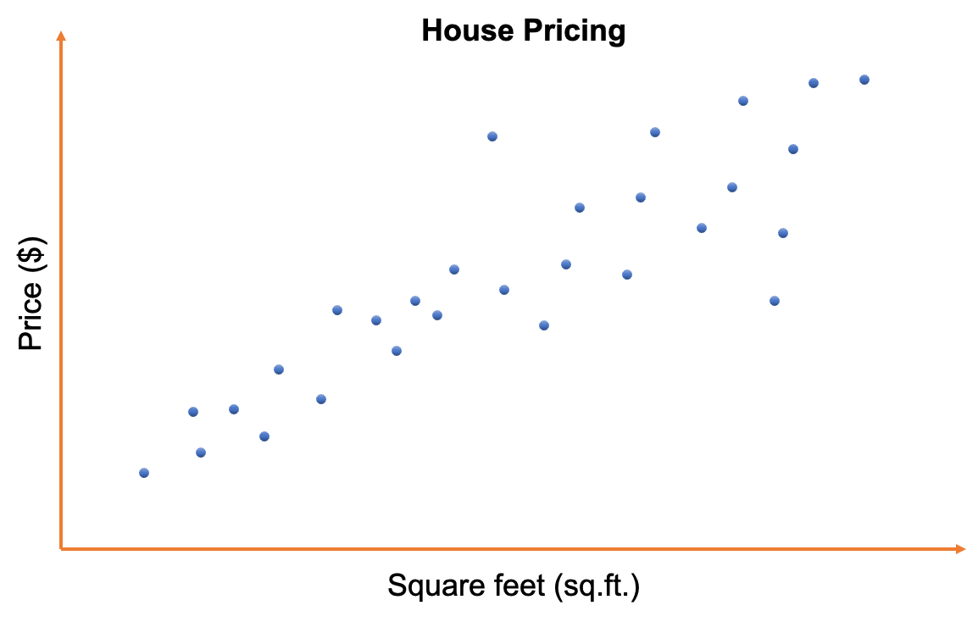
Linear Regression

Slide 10

Linear Regression

Slide 11

Linear Regression

Slide 12
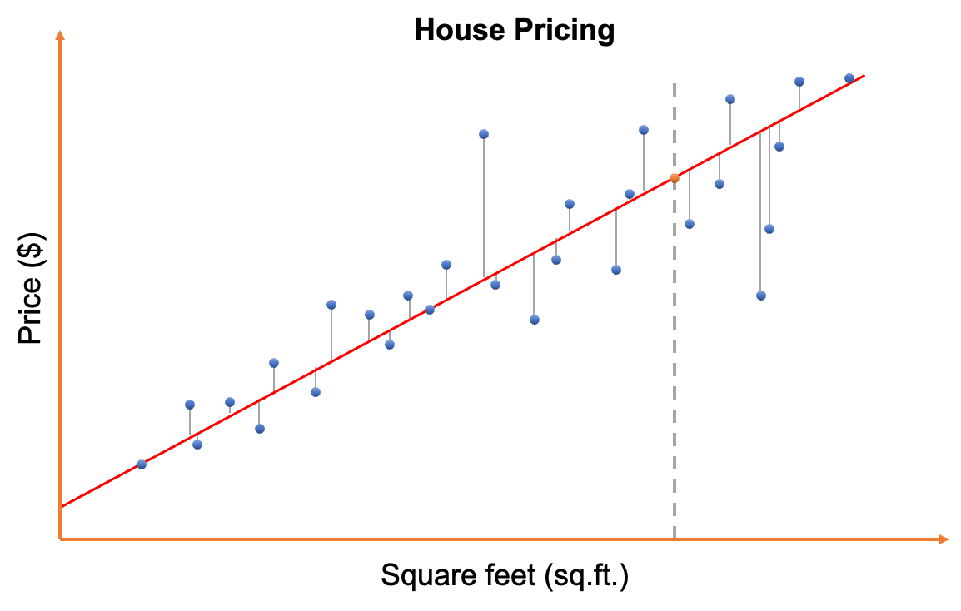
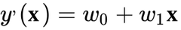
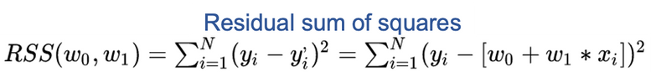
Linear Regression

Slide 13
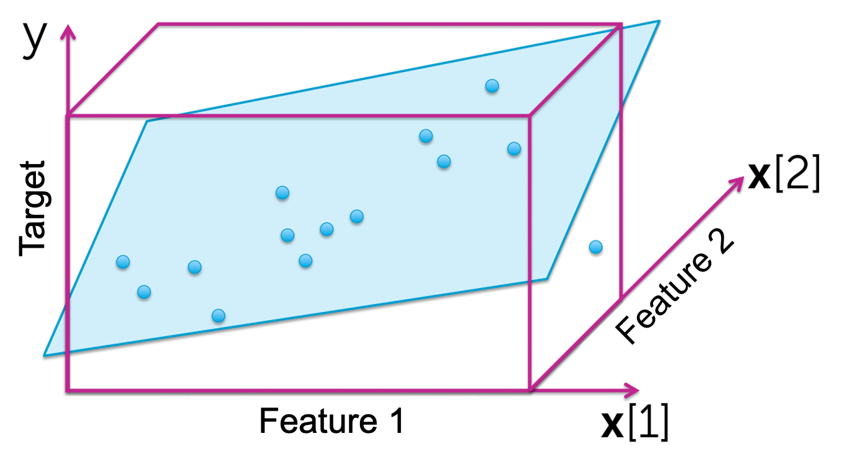
Linear Regression

Slide 14

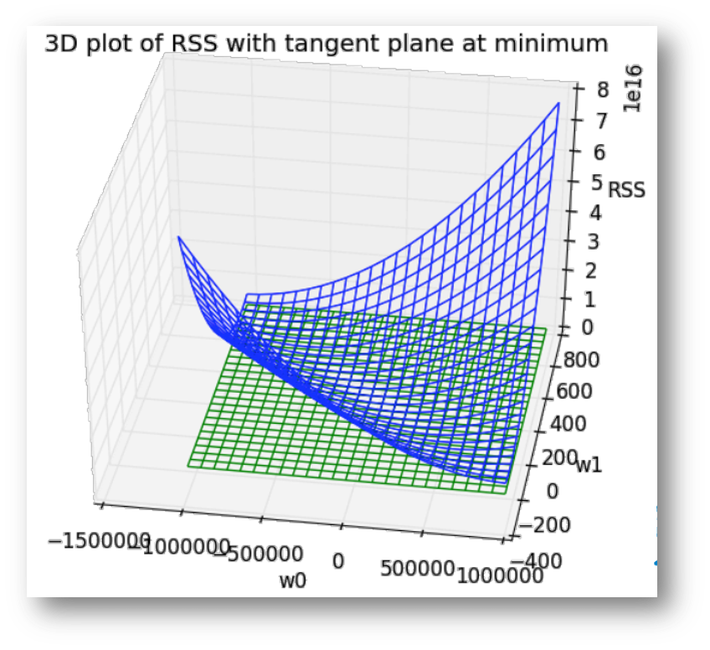
Linear Regression

Slide 15
Linear Regression
Pros
Robust
Easy to understand and interpret
Low computing cost
Cons
Only capture linear correlation
Affected by outliers
Requires normalized inputs
Can't easily handle categorical features

Slide 16
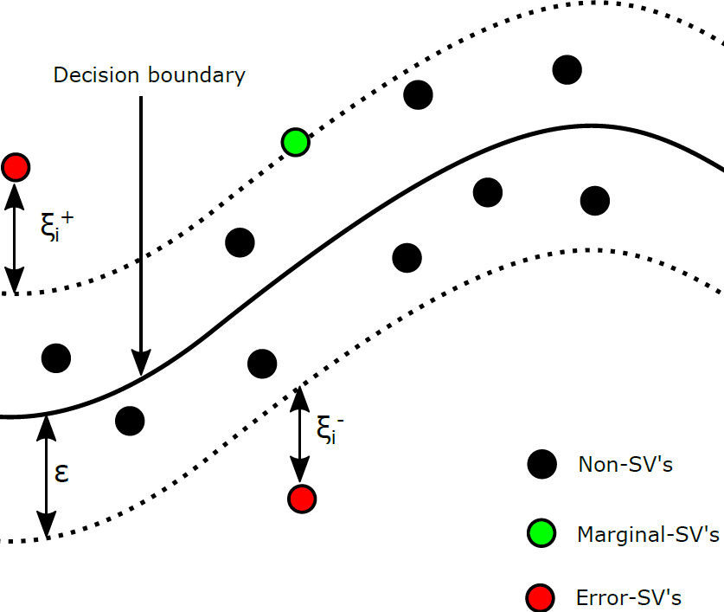
Part 3:
SV REGRESSOR

Slide 17
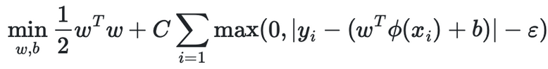
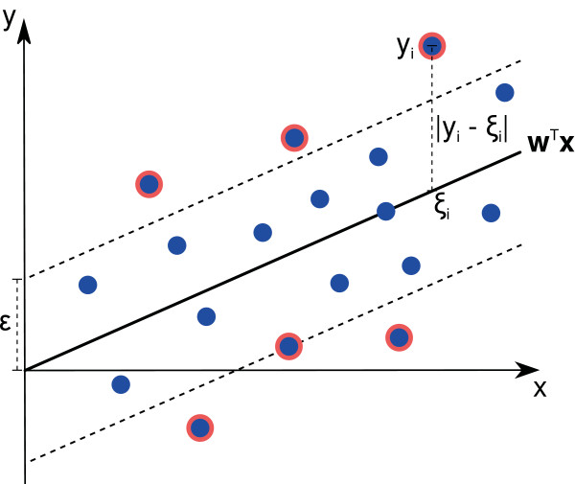
Suport Vector Regressor (SVR)
Find a line or curve that better fits the data
Optimize for more points inside the error interval
Can use different kernels, such as:
Linear: equation of a line
Poly: polinomial equation
RBF: radial-basis function, also known as "squared exponential"
Less affected by outliers
Source

Slide 18
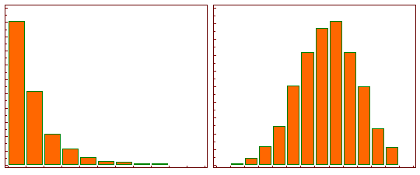
Log Transformation
Taking the logarithmic of a features approximates its distribution to a normal one.
Source

Slide 19
Suport Vector Regressor (SVR)
Pros
Robust
Can use different kernels
Less affected by outliers
Cons
Hard to parameterize
Requires normalized inputs
Can't easily handle categorical features
High computation cost

Slide 20

Part 4:
NEURAL NETWORKS

Slide 21
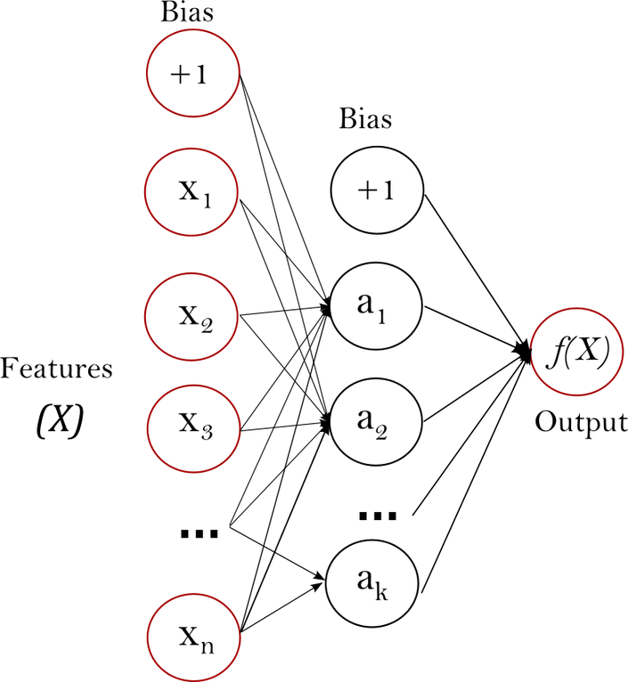
Neural Networks
Also called "multi-layer perceptron" (MLP)
Contains different types of layers:
Input layer: input features
Hidden layers: internal calculations
Output layer: predictions
MLP with 2 or more hidden layers are also called deep learning.
Source

Slide 22
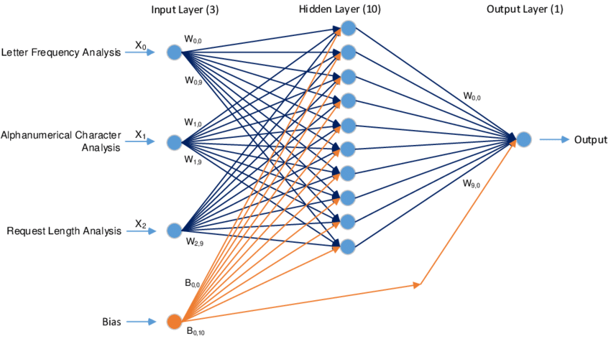
Neural Networks
Solve for the weights w
Source

Slide 23
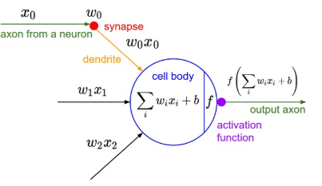

Activation Functions
Source
Source
Activation functions are used to introduce non-linearity to the model

Slide 24
Neural Networks
Pros
Non-linear
Flexible
Works in most scenarios
Cons
Hard to interpret
Requires normalized inputs
Can't easily handle categorical features
Requires a large amount of data
High computation cost

Slide 25

Part 5:
LIVE CODING (PYTHON)

